Slide 1
Nearest neighbor clustering algorithm

Slide 2
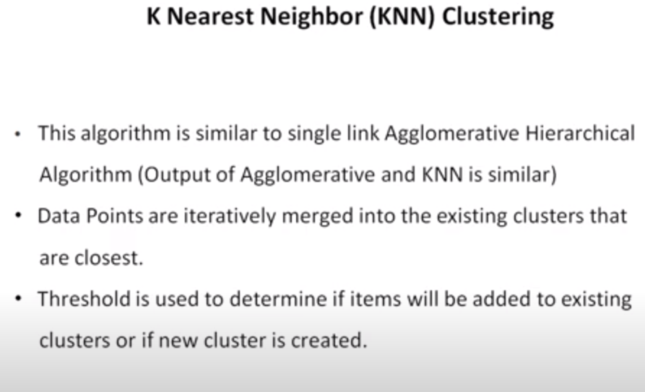

Slide 3
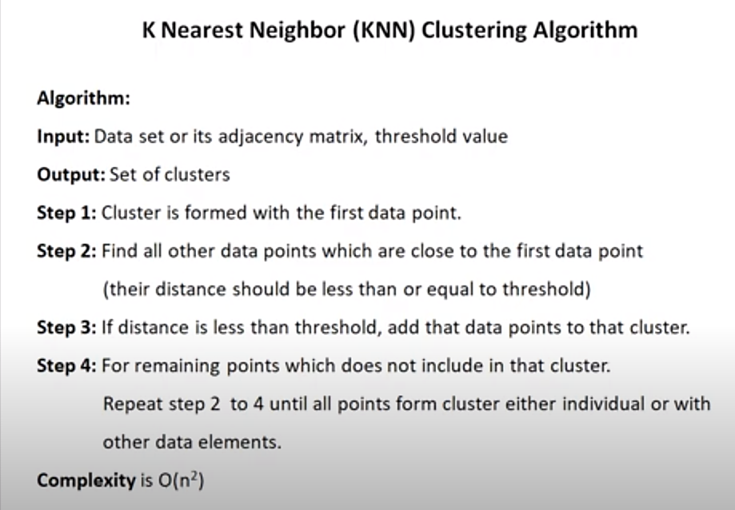

Slide 4
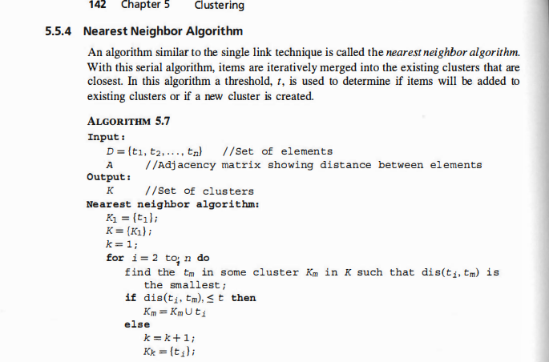

Slide 5
Given a dataset: do KNN clustering
point | X1 | x2
A1 | 2 | 10
A2 | 2 | 5
A3 | 8 | 4
A4 | 5 | 8
A5 | 7 | 5
A6 | 6 | 4
A7 | 1 | 2
A8 | 4 | 9
Step 1. Plot the data points in 2 dimensional space.
Step 2. Create the adjacency matrix or distance matrix, find distance from every point to every other point using Euclidian distance
Threshold is 4 which is given

Slide 6
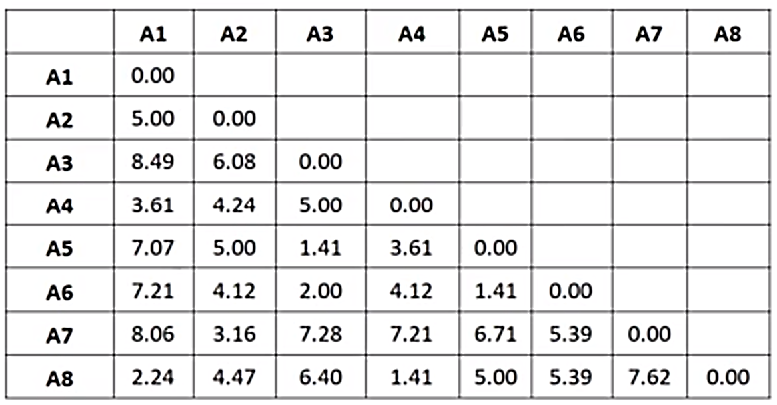
Create distance matrix

Slide 7
Create distance matrix
 | A1 | A2 | A3 | A4 | A5 | A6 | A7 | A8
A1 | 0
A2 | 5 | 0
A3 | 8.49 | 6.08 | 0
A4 | 3.61 | 4.24 | 5 | 0
A5 | 7.07 | 5 | 1.41 | 3.61 | 0
A6 | 7.21 | 4.12 | 2 | 4.12 | 1.41 | 0
A7 | 8.06 | 3.16 | 7.28 | 7.21 | 6.71 | 5.36 | 0
A8 | 2.24 | 4.47 | 6.40 | 1.41 | 5 | 5.39 | 7.62 | 0

Slide 8
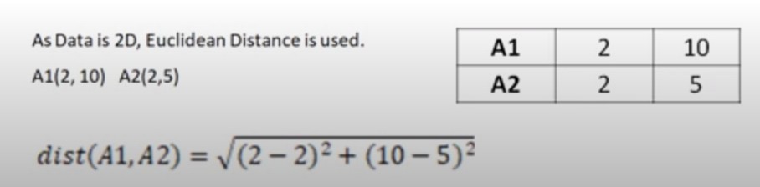

Slide 9
 | A1 | A2 | A3 | A4 | A5 | A6 | A7 | A8
A1 | 0
A2 | 5 | 0
A3 | 8.49 | 6.08 | 0
A4 | 3.61 | 4.24 | 5 | 0
A5 | 7.07 | 5 | 1.41 | 3.61 | 0
A6 | 7.21 | 4.12 | 2 | 4.12 | 1.41 | 0
A7 | 8.06 | 3.16 | 7.28 | 7.21 | 6.71 | 5.36 | 0
A8 | 2.24 | 4.47 | 6.40 | 1.41 | 5 | 5.39 | 7.62 | 0
Threshold Th =4
{A1, A4, A8,A5,A6,A3}
{A2,A7}

Slide 10
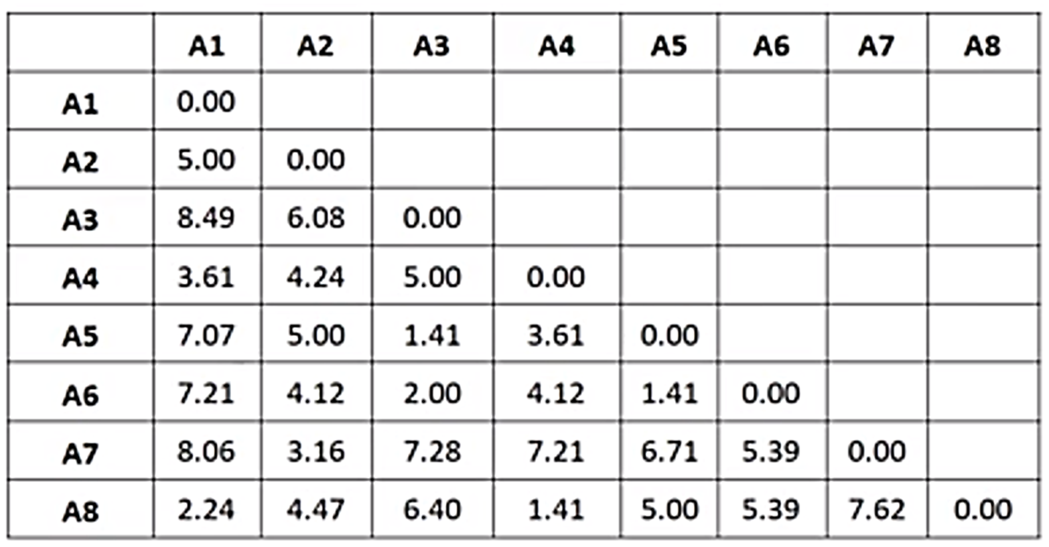
Dendrogram
Threshold Th =4
{A1, A4, A8,A5,A6,A3}
{A2,A7}
A1
A2
A3
A4
A5
4
3.5
3
2.5
2
1.5
A4 A 8 A1 A3 A5 A6 A2 A7

Slide 11
A dendrogram is a branching diagram that shows the relationships between similar objects, or entities, by representing them as a tree

Slide 12
Q : Now do with threshold 5

Slide 13
Reference
Part II: Nearest Neighbor Clustering Algorithm, Solved examples, Data Mining, Machine Learning - YouTube

